Slide 1
HOUSING

Slide 2
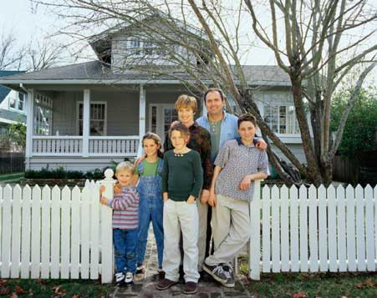
East, west home is best
Home is the place where you live together with other family members. The place where you are surrounded by the closest persons to you.
- it is your birthplace
- the place where you feel safe and relaxed
„Home is a place where you grow up wanting to leave, and grow old wanting to get back to.“ ~John Ed Pearce
„Home is not where you live but where they understand you.“ ~Christian Morgenstern

Slide 3
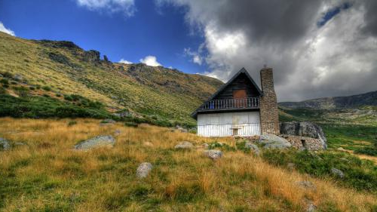
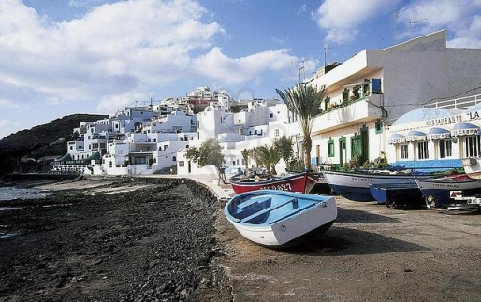
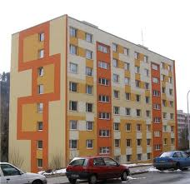
People can live at different places
in towns/cities
in villages/
countryside
in the mountains
by the seaside
on the beach/coast
in the suburb

Slide 4
The main types of houses in England are:
Detached (a house standing by itself)
Semi-detached (two houses joined together)
Terraced (several houses joined together)
Flats (apartments)
Bungalows (a house with one level)

Slide 5
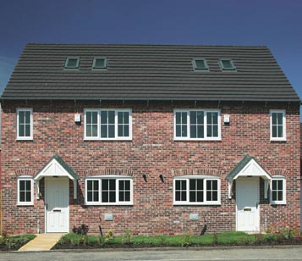
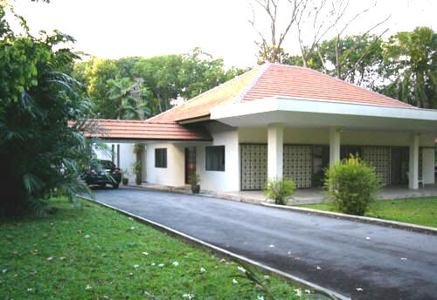
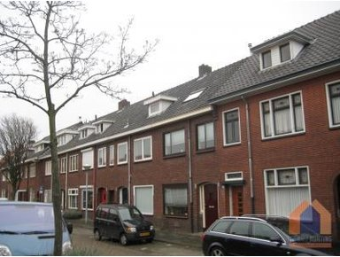
Housing in Britain
a semi-detached house
a detached house
a bungalow
terraced houses

Slide 6
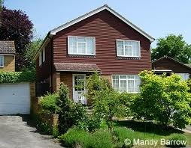
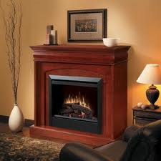
A typical British house
is set in a small garden and has two storeys
is designed for the family of four or five people
a garage is attached to the house
in the living room there is usually a fireplace
British people are fond of gardening so a beautiful lawn is their pride.

Slide 7
Town or village?
Pros of living in a town lots of shops (shopping facilities) more job opportunities better schooling possibilities more cultural opportunities more sports facilities there are hospitals less space in flats | Pros of living in a village closer to nature, clean air peace your own garden grow fruits and vegetables keep animals more space
Cons of towns polluted air, smog, crowded streets, hectic life sometimes high level of criminality noisy neighbours | Cons of villages more work around the house fewer shops, cultural and sports facilities people have to commute to towns to work, school more gossip, nosy neighbours

Slide 8
Young people and housing
Young couples, after marriage, can live with their parents
Or rent a flat
Buy a flat or a house and live on their own
WHAT TO DO IF THEY DON´T HAVE ENOUGH MONEY?
They can take out a loan from the bank called a mortgage

Slide 9
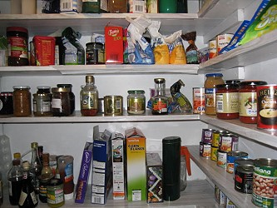
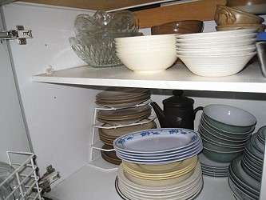
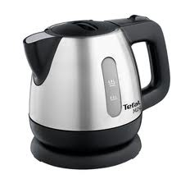
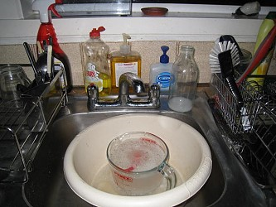
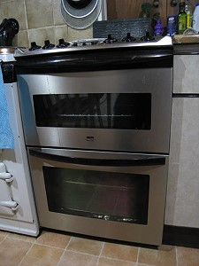
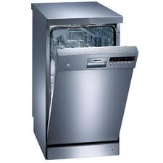
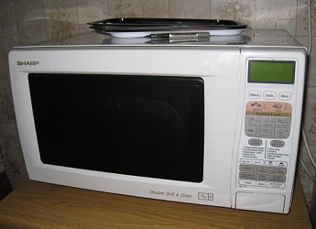
Kitchen

Slide 10
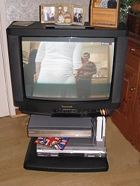
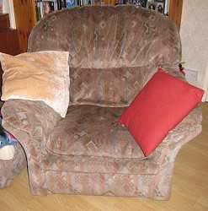
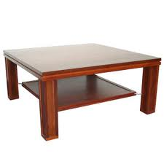
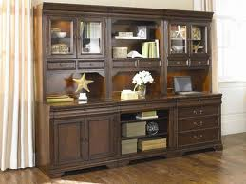
Living room

Slide 11
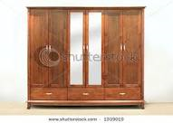
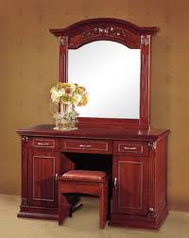
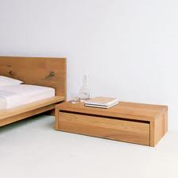
Bedroom

Slide 12
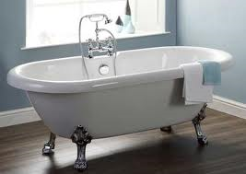
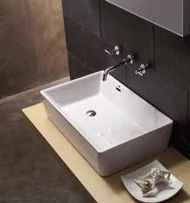
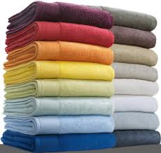
Bathroom

Slide 13
Answer the questions:
What is home?
What types of houses are there in Britain?
How do people pay for houses if they do not have enough money?
What is a typical British house like?
Pros and cons of towns and villages

