Slide 1
Examples and ideals

Slide 2
Qualities:
positive – virtues
( kindness, reliability, responsibility, honesty, generousity, politeness, friendship, good behaviour, hard-working etc.)
negative – vices
( laziness, people are mean, selfish, impolite, rude, cheeky, intolerant, reckless etc.)

Slide 3
People who influence us during the life
our parents
older siblings and other relatives
our friends
teachers at school
famous people or celebrities
All of them can influence us positively or
negatively

Slide 4
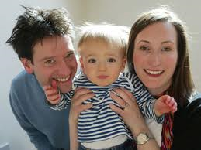
Parents
The most important and the
closest people to us
our first role models
they bring us up and teach us to behave well ( to get on with others, to greet and respect people, to help those in need)

Slide 5
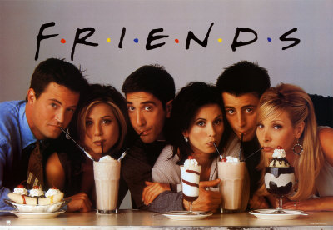
Friends (peers)
friends enrich our life, bring joy to it, and share our problems
choosing a friend is not easy
They can influence us positively and negatively
A good friend – helps us, supports us, understands us,
we spend lots of time together, we have
common hobbies, he/she doesn´t let you
down, doesn´t envy you
„Tell me who your friends are and I will tell you who you are.” (Assyrian proverb)

Slide 6
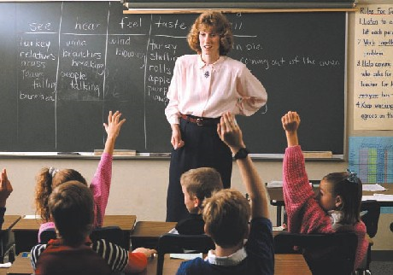
Teachers
teach children to be successful in
life, to cooperate with others, to be
self-disciplined, determined and hard-working
they encourage pupils to do their best at school
„Teachers open the door, but you must enter by yourself.“ (Chinese proverb)

Slide 7
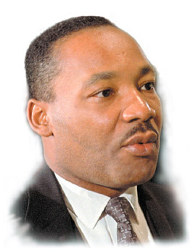
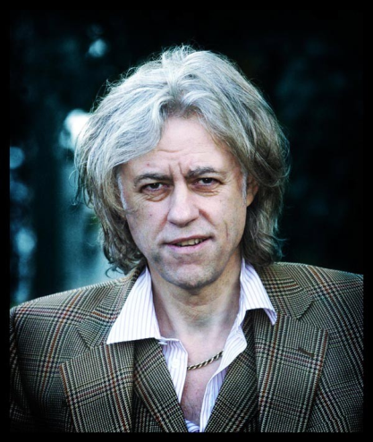
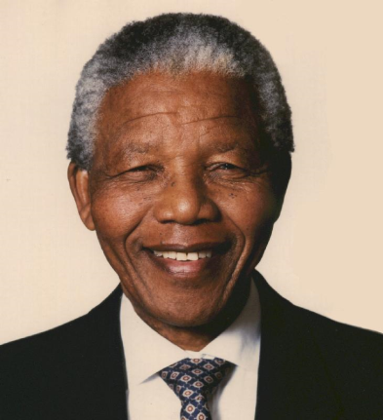
Celebrities – famous people
they can have a powerful impact on a person's life ( fashion styles, political views, interests, behaviour)
teenagers try to imitate them
they can have positive or negative impact on young people
GOOD EXAMPLES
M. Luther King
was an American activist who fought for civil rights of black people and against the racial segregation in USA in 1960s. In 1964, King received the Nobel Peace Prize Later he was killed.
Bob Geldof
Nelson Mandela
is an Irish singer, songwriter and political activist. He organised the charity super-concert to raise money for starving people in Ethiopia.
Imprisoned for over 20 years

Slide 8
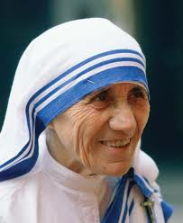
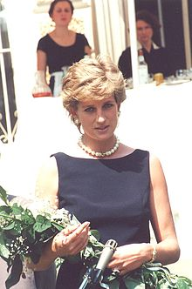
Others good examples among famous people
Angelina Jolie
An American actress, has adopted children fom Asia and Africa, she has worked for UNICEF to help children and refugees
Mother Teresa
She worked for charities and supported the international campaign to ban landmines
An Albanian nun living in India, she helped sick and poor people there
Princess Diana

Slide 9
Bad examples
A British singer, very talented but with lots of problems – she was drug and alcohol addicted, tried to commit suicide several times and had problems with depression. She died in July this year.
Amy Winehouse
A rich American businesswoman, loves partying and media attention
Paris Hilton

Slide 10
We should distinquish between:
ROLE MODEL - is a good example for us with a positive, good behaviour, we can find RM among relatives, famous people
Who is a your role model ?
Idol - is a person that we idolize and try to imitate, idols can also be negative examples for people - they imitate them in behaviour or clothing ( admire/adore)
Have you ever had any idol?

Slide 11
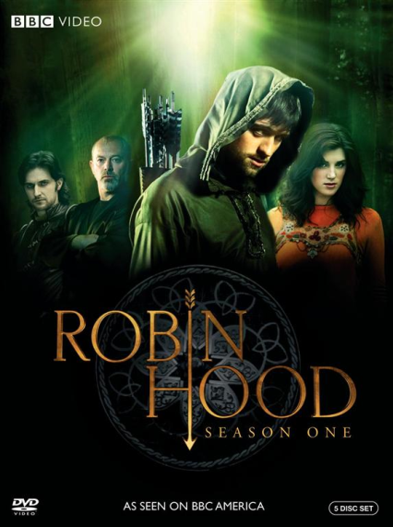
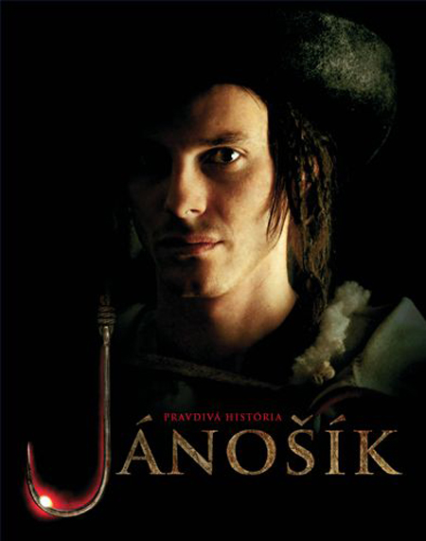
Literary or film heroes
People with high moral standarts
A young wizard, trying to overcome the evil wizard Lord Voldemort
An English outlaw - robber who robbed from the rich and gave to the poor

Slide 12
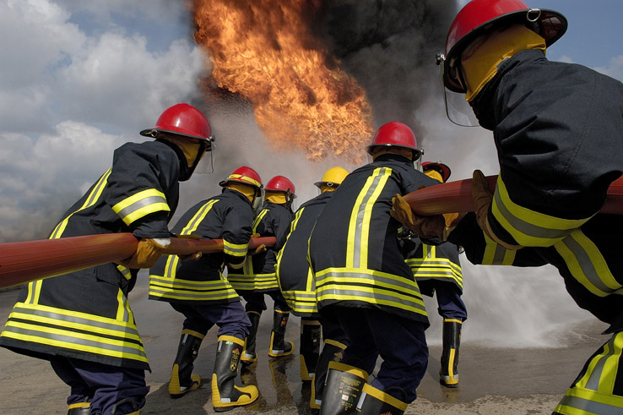
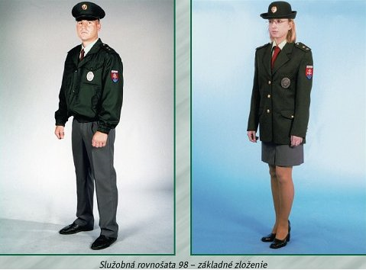
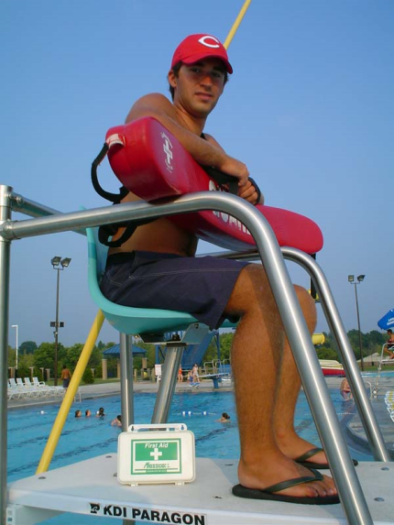
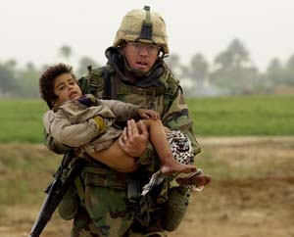
Everyday heroes
People who try to help other people and rescue their lives to save others
or help the victims of natural
disasters such as ........
firefighters
lifeguards
Policemen
doctors
soldiers

Slide 13
Answer the questions:
1. Are all people the same?
2. Compare the terms „role model“ and „idol“
3. Who influences us during our life?
4.Teenagers and famous people
5. What influence do celebrities have on young people? Give examples
6. Who are literary and everyday heroes?
7. What are your vices, virtues or bad habits? 8. Would you like to get rid of some of them?

